Slide 1
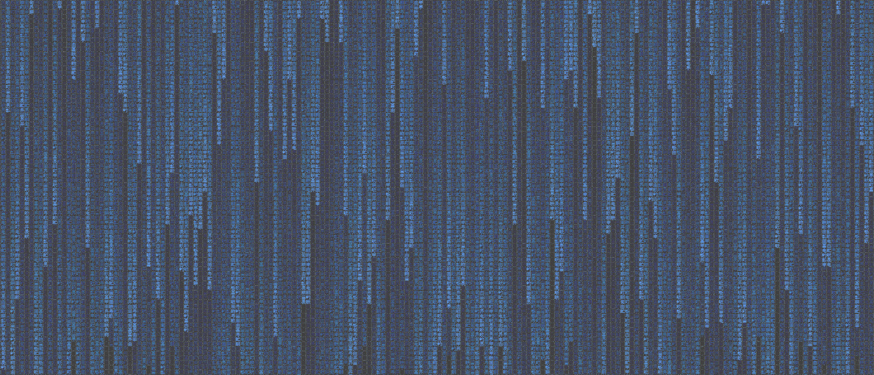


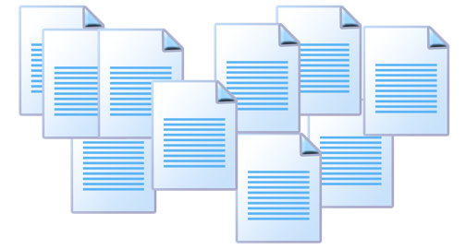


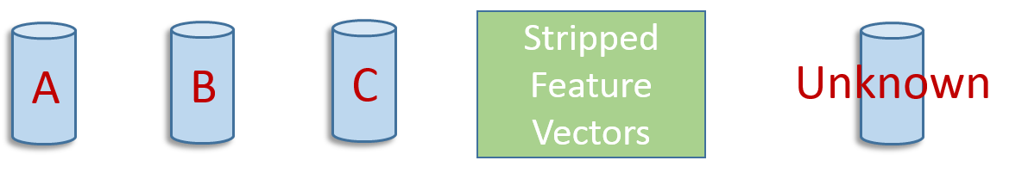
Identifying and Investigating the Feasibility
of Cross-Domain Authorship Analysis
Daway Chou-Ren¹, Dr. Byron Gao²
¹ Princeton University ² Texas State University
Preprocess and Form Corpus
Introduction
Why?
Online domains allow for anonymity
No way to get labeled posts from anonymous forum, email account, Facebook account, etc.
Can hopefully find labeled text from another domain– emails from court injunction, old schoolwork, etc.
Model and Methodology
Feature Set
An End-to-End System
Best experimental results are achieved using a neural network, though any classifier can be used. An aggregate ensemble fast correlation based filter works well for feature selection.
A Closer Look at Feature Extraction
Documents are split on multiple levels: by character, word, sentence, and by line. They are also tokenized for part of speech tagging and syntactic parsing through the Stanford NLP toolkit.
Results and Discussion
Model Validation
High accuracies for traditional problems
High accuracies for contemporary problems
Handles noise very well
5/9 misclassified documents for College Assignments were from author whose document set was split between journal entries and essays
Defining Domains
Same student may turn in a term paper similar to the Federalist Papers and a lab report similar to a research paper
Predicting College Assignments from each other is actually a cross-domain problem
Often form, audience, and purpose are intertwined– eg. blog posts vs online messaging vs academic essays
Other times, only one of the three may change: emails to a friend vs to a coworker
Abbasi et al.’s Writeprint clustering technique can be seen as attempting to find a single-domain solution from a cross-domain problem⁵
Domain-Independent Feature Set
Initial Results
Posts: brief, public reactions
Messages: possibly length and private conversations
Sample size too small, but tokens per suspect also small
Additional difficulty dealing with insufficient tokens per suspect⁶
Conclusion
This study investigated authorship analysis from a new direction focusing on cross-domain analysis
We identified and defined cross-domain analysis as a future direction in authorship studies
We validated a single-domain model and demonstrated relative failure for cross-domain applications
We achieved positive initial results on a small sample set, demonstrating feasibility of a potential solution
Future Research
Experiment with balanced feature set
Expand cross-domain corpus
Increase length of documents and number of samples
More pre- and post- processing
Test other domain combinations
Blogs, essays, emails, tweets
Acknowledgements
This work was made possible by the Texas State University Computer Science Department, Benjamin Fung, and Neil Gong. This research was funded by NSF REU award #1358939.
References
1. Rudman, Joseph. "The state of authorship attribution studies: Some problems and solutions." Computers and the Humanities 31, no. 4 (1997): 351-365.
2. Koppel, M., Schler, J., & Argamon, S. (2009). Computational methods in authorship attribution. Journal of the American Society for information Science and Technology, 60(1), 9-26.
3. Stamatatos, E. (2009). A survey of modern authorship attribution methods. Journal of the American Society for information Science and Technology, 60(3), 538-556.
Smalheiser, N. R., & Torvik, V. I. (2009). Author name disambiguation. Annual review of information science and technology, 43(1), 1-43.
Abbasi, A., & Chen, H. (2008). Writeprints: A stylometric approach to identity-level identification and similarity detection in cyberspace. ACM Transactions on Information Systems (TOIS), 26(2), 7.
Layton, R., Watters, P., & Dazeley, R. (2010, July). Authorship attribution for twitter in 140 characters or less. In Cybercrime and Trustworthy Computing Workshop (CTC), 2010 Second (pp. 1-8). IEEE.
Contact Information
Daway Chou-Ren: dchouren@princeton.edu
Traditional Problem
Given an anonymous document, can we identify which candidate’s writings samples it most closely resembles?
Solution: Extract stylometric features from writing samples, use statistical or machine learning algorithms to classify unknown document¹
Applications: the Federalist Papers, Shakespeare plays, poetry, newspaper articles, novels²
Commonality? All print-based, large samples available, well-formed writing, same topic, few candidate authors
Scraped or Processed Documents
Corpus | # of Suspects | Tokens per Suspect | Dummy classification
Facebook Posts from Facebook Messages | 8 | 250 – 1500 | 5/8
Labeled
Extract Feature Vectors
Unknown
Corpus | # of Suspects | Tokens per Suspect | Accuracy | Dummy Classification
Federalist Papers | 4 | 9,000 – 150,000 | 97% | 11/12
Sports Columns | 6 | 2000 x 10 = ~20,000 | 93% | –
Research Papers | 3 | 7500 x 15 = ~100,000 | 100% | 11/15
College Assignments | 10 | 25,000 x 6 = 150,000 | 88% | –
Postprocess and Normalize
A
B
C
Candidate Document Sets
Unknown
Contemporary Problem
Can we identify shorter, noisier electronic documents that have more candidate authors?
Solution: Increase feature sets, incorporating misspellings, emoticons, document structure, Internet lingo, etc. ³
Applications: chat logs, forum posts, emails, tweets⁴
Commonality? Short samples, noisy, many candidates, but single-domain
A
B
C
Full
Feature Vectors
Unknown
Federalist Papers | Sports Columns | Research Papers
In the extent and proper structure of the Union, therefore, we behold a republican remedy for the diseases most incident to republican government. | June 2011: Detroit, $325 million October 2011: Philly, $280 million June 2012: New Orleans, $338 million October 2012: Memphis, $377 million | [3] proposes a proba- bilistic framework based on Hidden Markov Random Fields, incorporating supervision into k-clustering al- gorithms. [8]
Neural Network
Our New Cross-Domain Problem
Is it possible to use writing samples to identify an unknown message from a different domain? Can a blog post be used to identify an email? Or a Facebook message a tweet?
B
Two documents may be considered to exist in separate domains when required document structure, purpose, or audience changes structural, syntactic, or lexical patterns, but not content.
Who wrote this document?
Feature | Count | Example
Word/sentence-based frequencies | 23 | # tokens
Character-based frequencies | 63 | a-z, 0-9
Vocabulary richness metrics | 4 | Sichel’s S
Capitalization types | 4 | ALL CAPS
Function word frequencies | 260 | a, an, and
Internet lingo frequencies | 116 | lol, haha
Part of speech tags and bigrams | 51 | NN NNPS
Syntactic parent-child pairs | 769 | VB VBD
Total | 1290
(ROOT
(SBARQ
(WHNP (WP Who))
(SQ
(VP (VBD wrote)
(NP (DT this) (NN document))
(. ?)))
Who/WP wrote/VBD this/DT document/NN
?/.
[ROOT SBARQ], [SBARQ WHNP], [SBARQ SQ], [SBARQ .],
[WHNP WP], [SQ VP], [VP VBD]
[VP NP], [NP DT], [NP NN]
WP VBD
VBD DT
DT NN
NN .
Context Independence
Interpretability
Document length
Word meanings
Trigrams, 4-grams
Internet Lingo

